Slide 1
Regular Language

Slide 2
Finite Automata
The simplest computational model is called a finite state machine or a finite automaton
Representations:
Graphical
Tabular – good for state transactions, not for start state and final states
Formal description

Slide 3
Formal Definition of Finite Automata
A finite automaton is a 5-tuple (Q,Σ, δ, q₀, F) where:
Q is a finite set called the states
Σ is a finite set called the alphabet
δ : Q × Σ → Q is the transition function
q₀ ∈ Q is the start state also called initial state
F ⊆ Q is the set of accept states, also called the final states

Slide 4
Questions
1. Can we have more than one state as the start state?
Can we have more than one state as the final state?

Slide 5
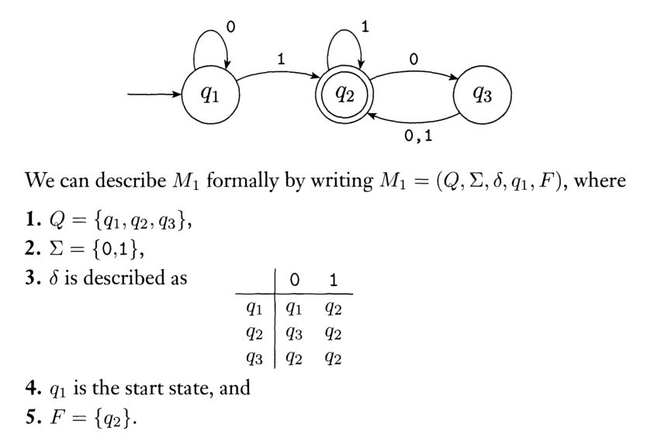
First Example
The state diagram and the formal description are equivalent, only the format is different.

Slide 6
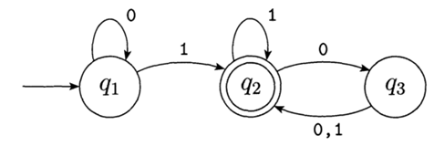
First Example
For M₁, L(M₁) = A {w | w contains at least one 1, then either ends with a 1 or an even number of 0s follow the last 1}
Note number of 0s must be an even number!

Slide 7
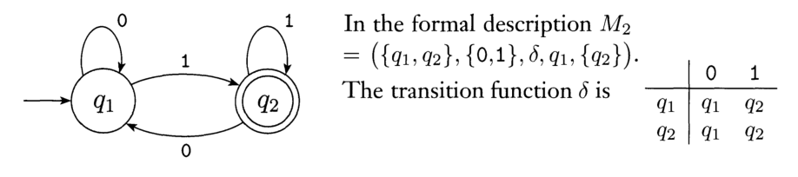
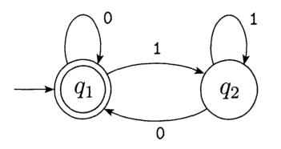
Examples
Page 37 M₂ represents all binary odd numbers
Page 38 M₃ represents all even numbers and a starting empty string.

Slide 8
Language of a Machine
If A is the set of all strings that a finite automaton M accepts, we say that A is the language of the machine M and write L(M) = A.
We can also say M recognizes A or M accepts A
An automaton may accept several strings, but it always recognizes only one language
If a machine accepts no strings, it still recognizes one language, namely the empty language ∅!

Slide 9
Formal Definition of Acceptance
Let M = (Q, Σ, δ, q₀, F) be a finite automaton and w = a₁a₂ . . . a_{n} be a string over Σ.
Then M accepts w if a sequence of states r₀, r₁, . . . , r_{n} exist in Q such that the following hold:
1. r₀ = q₀
2. δ(r_{i}, a_{i+1}) = r_{i+1} for i = 0, 1, . . . , n − 1
3. r_{n} ∈ F
Condition (1) says where the machine starts.
Condition (2) says that the machine goes from state to state according to its transition function.
Condition (3) says when the machine accepts its input if it ends up in an accept state.

Slide 10
Regular Languages
We say that a finite automaton M recognizes the language A if A = {w | M accepts w}
Definition
A language is called a regular language if there exists a finite automaton that recognizes it.

Slide 11
Designing Finite Automata
It is a creative process and cannot be reduced to a simple recipe or formula.
The approach: Identify the finite pieces of information you need to solve the problem. These are the states.
Identify the condition (alphabet) to change from one state to another.
Identify the start state and final states.
Add missing transitions.

Slide 12
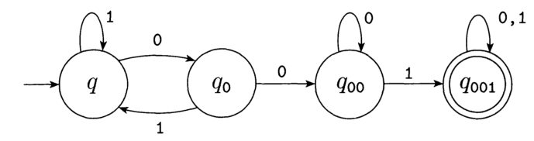
Example of designing a FA
Designing a FA to recognize the regular language of strings containing 001 as a substring. (Example 1.21, page 43)
So, 0010, 1001, 11110001111 are in the language. However, 11, 101, 0000 are not.
The states are seeing 0 (q₀), 00 (q₀₀), and 001 (q₀₀₁). We also need a state for not yet seeing the first 0 (q).
Here is the State Diagram

Slide 13
Operations on Regular Languages
Let A and B be regular languages. We define regular operations
union, concatenation, and star as follows:
Union: A ∪ B = {x | x ∈ A ∨ x ∈ B}
Concatenation: A ◦ B = {xy | x ∈ A ∧ y ∈ B}
Star: A* = {x₁x₂ . . . x_{k} | k ≥ 0 ∧ x_{i} ∈ A, 1 ≤ i ≤ k} Note:
(1) Because “any number" includes 0, ε ∈ A *, no matter what A is.
(2) A+ denotes A ◦ A*.

Slide 14
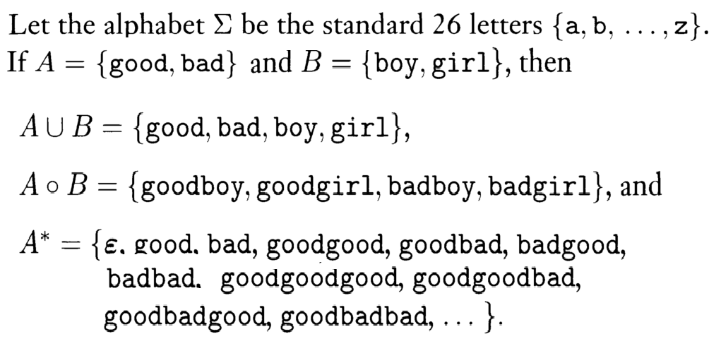
Example (1.4 page 45)

Slide 15
Closed
Integer operations are closed
That class of regular languages is closed under complementation.
Proof: For that we will first show that if M is a DFA that recognizes a language B, swapping the accept and non-accept states in M yields a new DFA that recognizes the complement of B.
The class of regular language is closed under the union and concatenation operations (read the proof ☺)

Slide 16
Non-determinism
So far in our discussion, every step of a finite automaton computation follows in a unique way from the preceding step.
We call this a deterministic computation. In a nondeterministic computation, choices may exist for the next state at any point.
Nondeterminism is a generalization of determinism; hence, every finite automaton is a nondeterministic finite automaton (NFA).

Slide 17
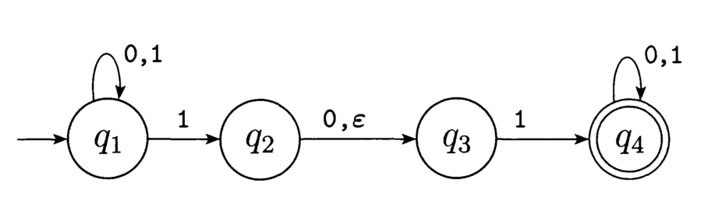
Two ways to Introduce Nondeterminism
More choices for the next state: Zero, one, or many arrows may exit from each state.
For example, for figure 1.27 on page 48, at q₁ reads a 1 can go back to q₁ or to q₂

Slide 18
Two ways to Introduce Nondeterminism (2)
A state may change to the next state without spending an input symbol: ε-transitions.
Example, for figure 1.27 on page 48, at q₂ reads a 0 can go back to q₃ or read nothing (ε) can go to q₃ as well

Slide 19
Tree Computation of NFA
A way to think of a nondeterministic computation is as a tree of possibilities
The root of the tree corresponds to the start of the computation
Every branching point in the tree corresponds to a point in the computation at which the machine has multiple choices
The machine accepts if at least one of the computation branches ends in an accept state.

Slide 20
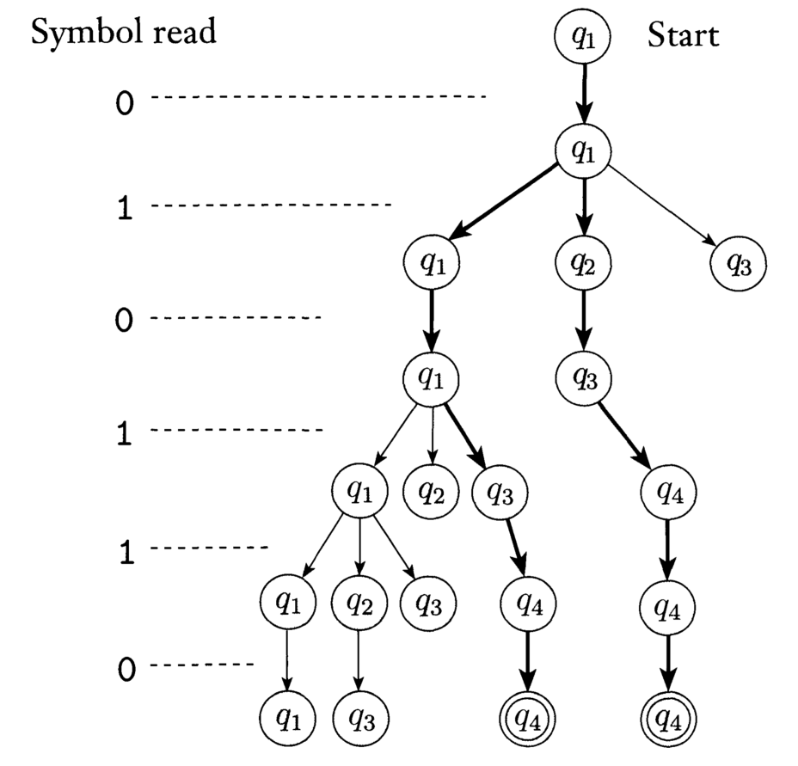
Example of page 49
N accepts all string that has 101 or 11 as substring

Slide 21
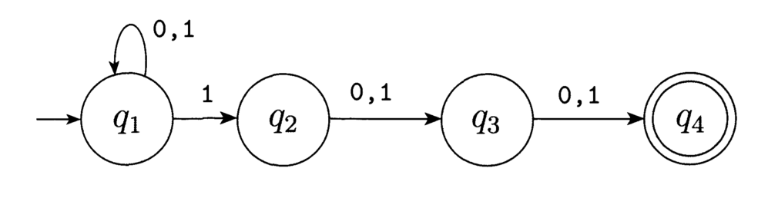
The power of NFA
See the example of 1.30 on page 51. It accept any binary number with the third position from the end is a 1.

Slide 22
Two NFA are different

Slide 23
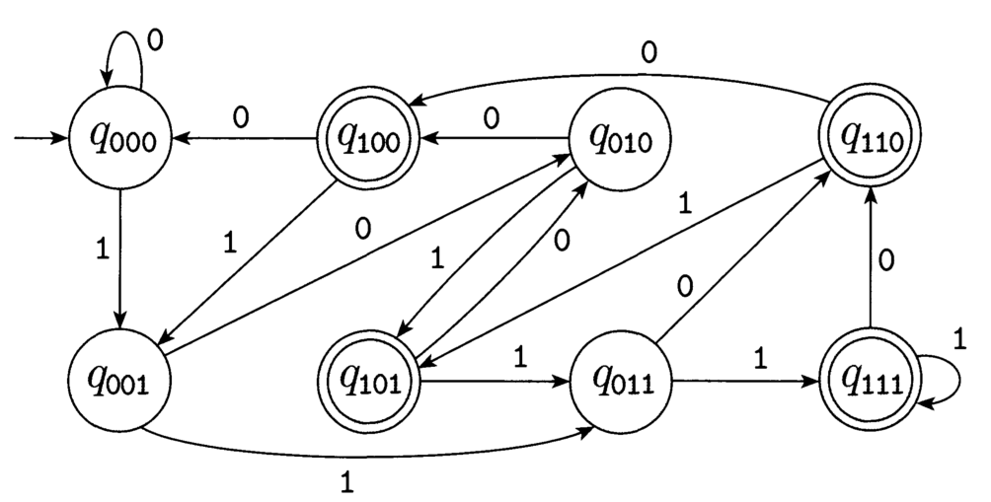
An NFA its twin (equivalent) DFA

Slide 24
Formal Definition of NFA
An NFA is a 5-tuple (Q, Σ, δ, q₀, F) where:
Q is a finite set called the states
Σ is a finite set called the alphabet
δ : Q × (Σ ∪ {ε}) → P(Q) where P(Q) is the power set of Q.
q₀ ∈ Q is the start state also called initial state
F ⊆ Q is the set of accept states, also called the final States
In a DFA transition function is δ : Q × Σ _{ε} → Q.
notation: For any alphabet Σ, Σ _{ε} = Σ ∪ {ε}

Slide 25
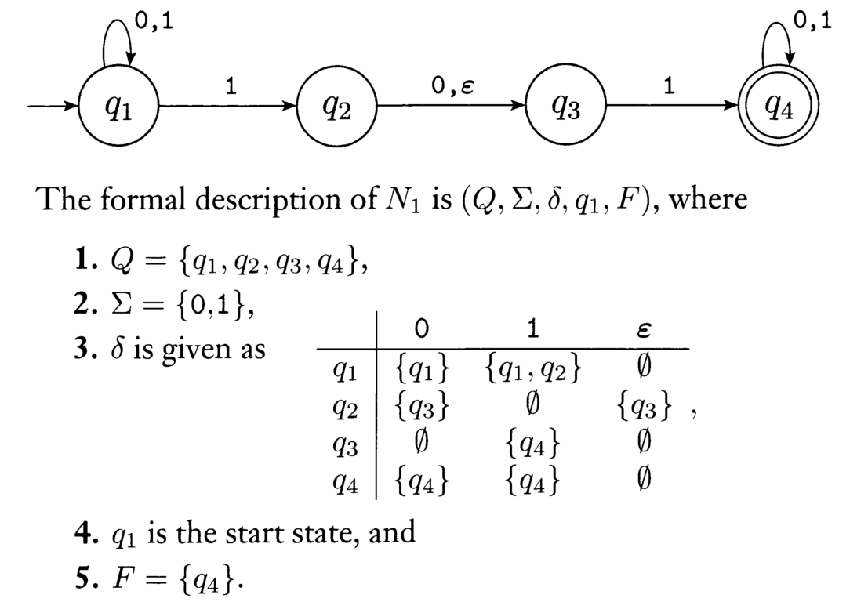
Example
Page 54 example 1.38

Slide 26
NFA vs. DFA
Constructing NFA is sometimes easier than that of DFA
An NFA may be much smaller than a DFA that performs the same task.
Computation of NFA is usually more expensive than that of DFA.
Every NFA can be converted into an equivalent DFA.
NFA provides good introduction to nondeterminism in more powerful computational models.

Slide 27
Equivalence of NFAs and DFAs
Every NFA has an equivalent DFA.
That is, if a string can be accepted by an NFA, the string can be accepted by a DFA.
The proof is on page 55.
Question?
Can we say: if a string can be accepted by a DFA, the string can be accepted by a NFA?

Slide 28
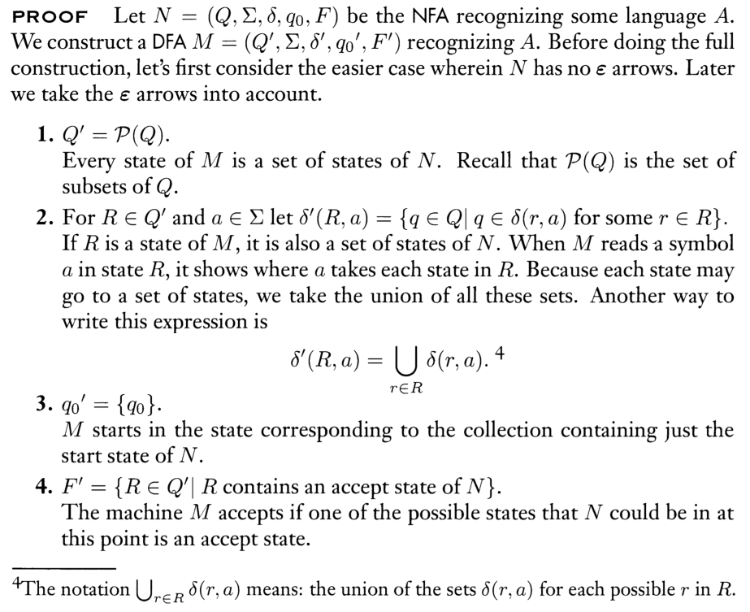
Equivalence of NFAs and DFAs

Slide 29
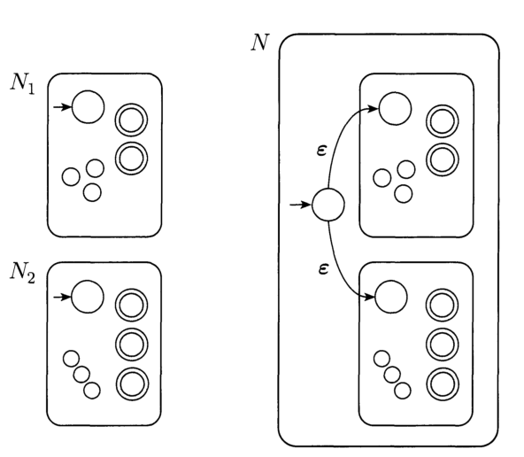
NFA makes prove simple - UNION

Slide 30
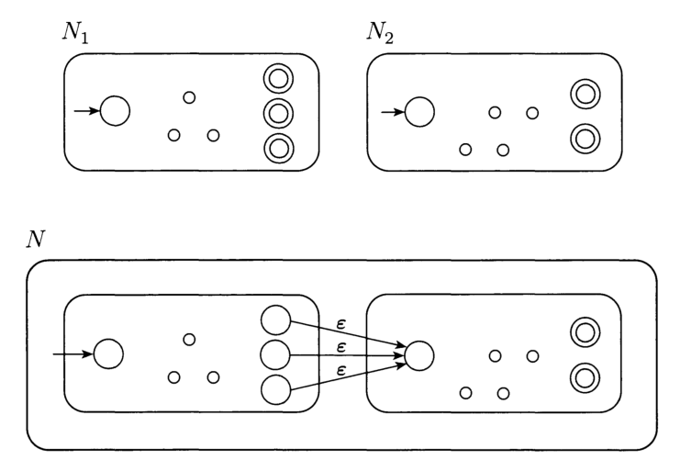
NFA makes prove simple - Concatenate

Slide 31
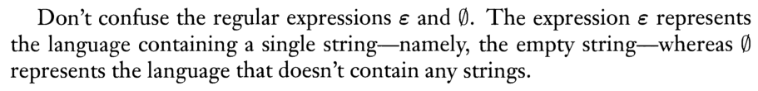
Regular Expressions
Three base cases:
∅ is a regular expression denoting the language ∅;
ε is a regular expression denoting the language {ε};
For any a ∈ , a is a regular expression denoting the language {a};
Three recursive cases: If r₁ and r₂ are regular expressions denoting languages L₁ and L₂, respectively, then
Union: r₁ ∪ r₂ denotes L₁ ∪ L₂;
Concatenation: r₁r₂ denotes L₁L₂;
Star: r₁* denotes L₁*

Slide 32
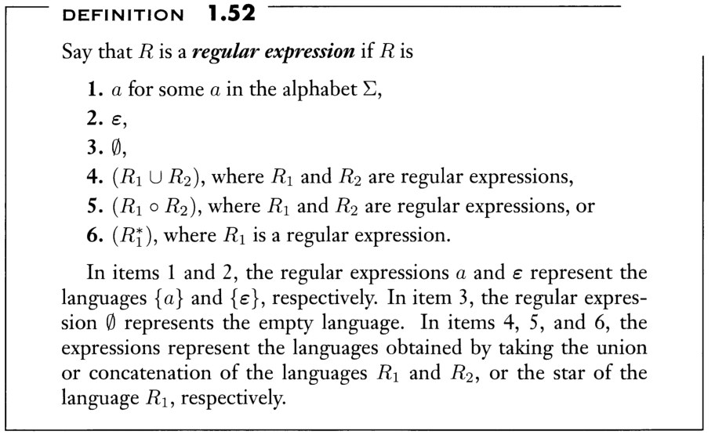
Regular Expressions (from the book)

Slide 33
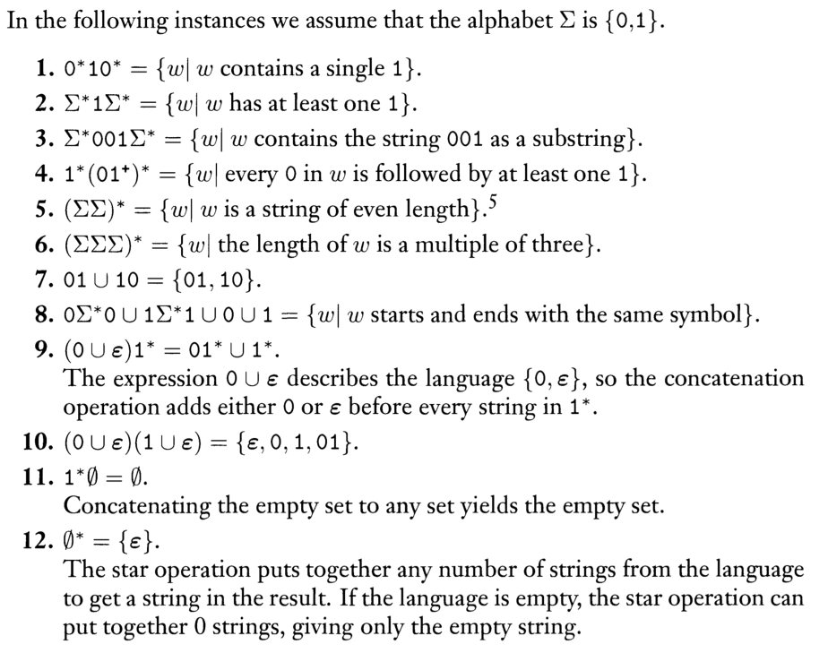
Example 1.53 (page 65)
Check to see if you agree with the author
Try this one
R⁺∪ε = R*

Slide 34
Theorem 1.54
A language is regular if and only some regular expression describes it.
Generally, it is easy to create a NFA for a regular expression

Slide 35
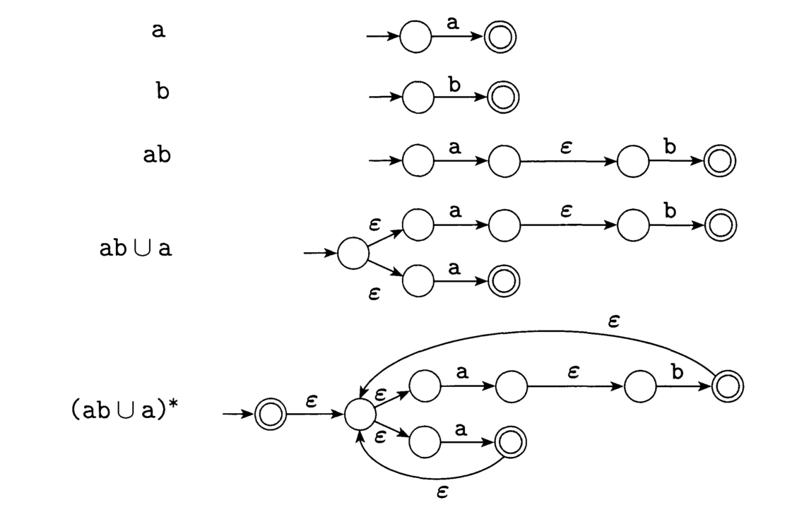
Example 1.56 (ab U a)*

Slide 36
Non-regular Language
Consider the language B = {0^{n}1^{n}|n ≥ 0}.
If we attempt to find a DFA that recognizes B we discover that such a machine needs to remember how many 0s have been seen so far as it reads the input
Because the number of 0s isn’t limited, the machine needs to keep track of an unlimited number of possibilities
This cannot be done with any finite number of states
We cannot do
C = {w|w has an equal number of 0s and 1s}
Language B and C are non-regular!

Slide 37
Language nonregularity
The technique for proving nonregularity of some languages is provided by a theorem about regular languages called pumping lemma
Pumping lemma states that all regular languages have a special property
If we can show that a language does not have this property we are guaranteed that it is not regular

Slide 38
Pumping property
All strings in the language can be “pumped" if they are at least as long as a certain special value, called the pumping length
Meaning: each such string in the language contains a section that can be repeated any number of times with the resulting string remaining in the language.

Slide 39
Theorem 1.70
Pumping Lemma: If A is a regular language, then there is a number p (the pumping length) where, if s is any string in A of length at least p, then s may be divided into three pieces, s = xyz, satisfying the following conditions:
1. for each i ≥ 0, xy^{i}z ∈ A
2. |y| > 0
3. |xy| ≤ p

Slide 40
Proof idea
Let M = (Q,Σ, δ, q1, F) be a DFA that recognizes A
Assign a pumping length p to be the number of states of M
Show that any string s ∈ A, |s| ≥ p may be broken into three pieces xyz satisfying the pumping lemma’s conditions
If there are no strings in A of length at least p then theorem becomes true because all three conditions hold for all strings of length at least p if there are no such strings

Slide 41
Pumping lemma’s proof
Let M = (Q, Σ, δ, q1, F) by a DFA recognizing A and p be the number of states of M; let s = s₁s₂ . . . s_{n} be a string over with n ≥ p and r₁, r₂, . . . , r_{n+1} be the sequence of states while processing s, i.e., r_{i+1} = δ(r_{i}, s_{i}), 1 ≤ i ≤ n
n + 1 ≥ p + 1 and among the first p + 1 elements in r₁, r₂, . . . , r_{n+1} two must be the same state (pigeonhole principle) , say r_{j} , r_{k}.
Because r_{k} occurs among the first p + 1 places in the sequence starting at r1, we have k ≤ p + 1
Now let x = s₁ . . . _{sj−1}, y = s_{j} . . . s_{k−1}, z = s_{k} . . . s_{n}.

Slide 42
Pumping lemma’s proof (2)
As x takes M from r₁ to r_{j} , y takes M from r_{j} to r_{j} , and z takes M from r_{j} to r_{n+1}, which is an accept state, M must accept xy^{i}z, for i ≥ 0
We know that j ≠ k, so |y| > 0;
We also know that k ≤ p + 1, so |xy| ≤ p
Thus, all conditions are satisfied and lemma is proven

Slide 43
Using pumping lemma
Prove that a language A is not regular using pumping lemma:
1. Assume that A is regular in order to obtain a contradiction
2. The pumping lemma guarantees the existence of a pumping length p such that all strings of length p or greater in A can be pumped
3. Find s ∈ A, |s| ≥ p, that cannot be pumped: demonstrate that s cannot be pumped by considering all ways of dividing s into x,y,z, showing that for each division one of the pumping lemma conditions, (1) xy^{i}z ∉ A, (2) |y| > 0, (3) |xy| ≤ p, fails.

Slide 44
Examples
1.73 B = {0^{n}1^{n}|n ≥ 0} is not regular
1.74 C = {w|w has an equal number of 0s and 1s} is not regular
1.75 F = {ww|w ∈ {0, 1}} is nonregular
1.76 E = {0^{i}1^{j} |i > j} is not regular

Slide 45
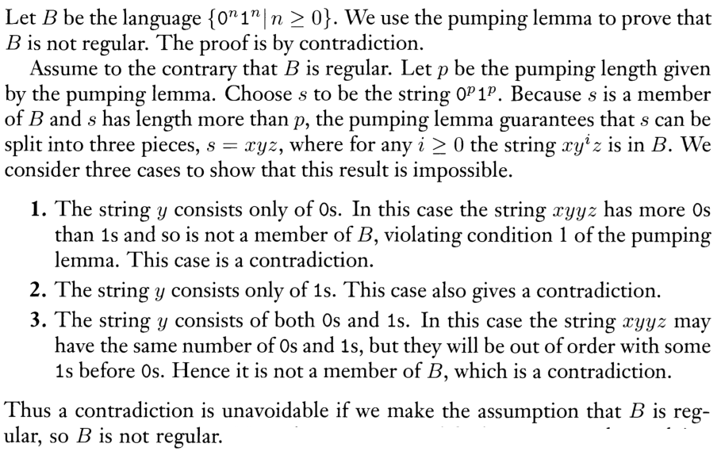
Example 1.73 (page 80)

Slide 46
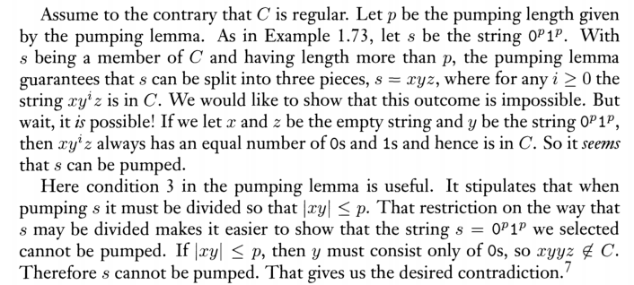
Example 1.74 (page 80~81)
C = {w|w has an equal number of 0s and 1s} is not regular

Slide 47
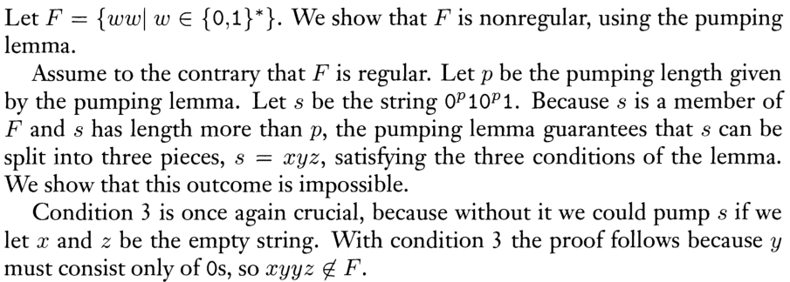
1.75 F = {ww|w ∈ {0, 1}} is nonregular

Slide 48
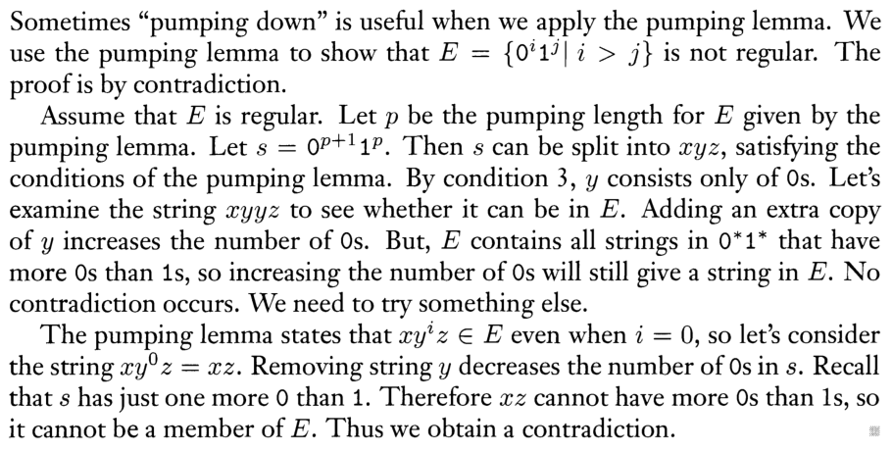
E = {0^{i}1^{j} |i > j} is not regular

Slide 49
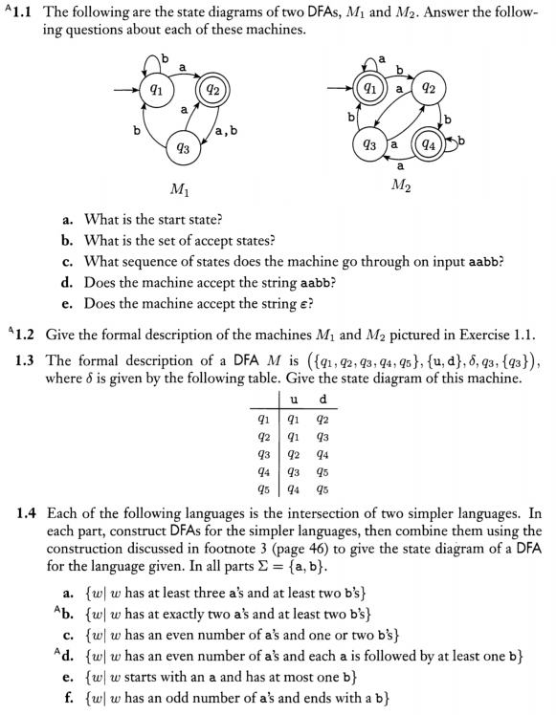
Exe #4, no need to turn in, ask in class if you have questions

